Slide 1
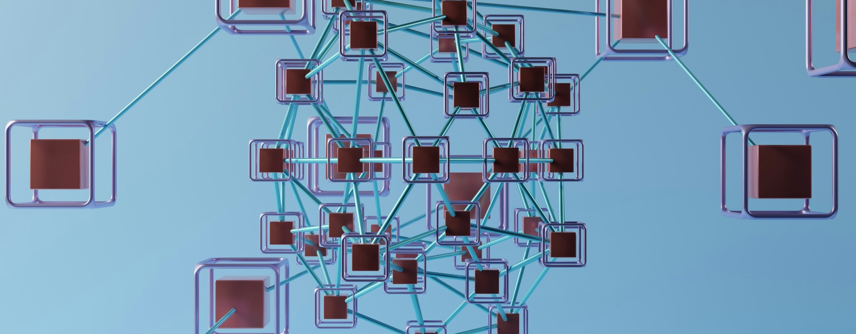
Unlocking the Power of Vector Stores: Revolutionizing Similarity Search
Pravin Menghani
Discover how vector stores revolutionize similarity search and unlock new possibilities for data-driven applications.

Slide 2



What is a Vector Store?
High-dimensional Vector Database
Similarity Search Capabilities
Flexible Data Storage
A vector store is a specialized database that stores and manages high-dimensional vectors.
The stored vectors can be used to perform efficient similarity searches on data, allowing for retrieval of similar items based on their vector representations.
Vector stores can store a wide range of data types, including text, images, and other multimedia, by breaking them down into smaller chunks and calculating their vector embeddings.
Vector stores are a powerful tool for building applications that require efficient similarity-based data retrieval, enabling new and innovative solutions across various domains.

Slide 3




How Does a Vector Store Work?
Break Down Data into Chunks
Calculate Embeddings
Store Chunks and Embeddings
Retrieve Relevant Data
The first step is to take the data you want to store in the vector store and break it down into smaller, manageable chunks or segments.
Once you have the data chunks, you'll use a large language model to calculate high-dimensional embeddings for each of these chunks. The embeddings capture the semantic meaning and relationships within the data.
The vector store will then take the data chunks and their corresponding embeddings, and store them together. The vector store uses the embeddings to create an internal index, which allows for efficient similarity searches.
When a user provides a query, the vector store will calculate the embedding for the query, and then use that embedding to find all the similar embeddings in its index. The vector store will then return the data chunks associated with those similar embeddings, providing the user with the most relevant information.

Slide 4
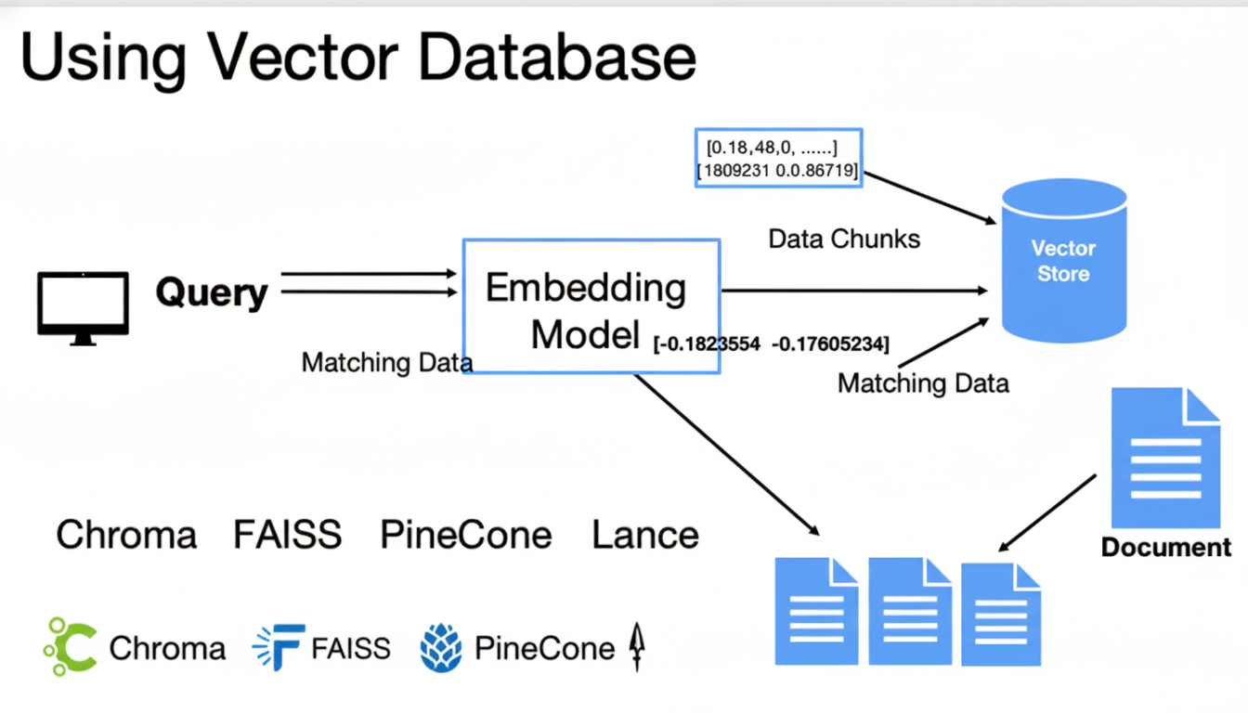

Slide 5
Benefits of Vector Stores
Efficient Similarity Search
Scalable Data Storage
Flexible Query Capabilities
Vector stores enable efficient retrieval of data based on the similarity of its embeddings, making them ideal for building similarity search applications.
Vector stores can handle large volumes of data by storing and indexing high-dimensional vectors, allowing for scalable data storage solutions.
Users can query vector stores using embedding-based searches, allowing for more nuanced and contextual retrieval of relevant data.
Improved Relevance
Easy Integration
By leveraging the semantic understanding of embeddings, vector stores can deliver more relevant and accurate search results compared to traditional keyword-based approaches.
Vector stores can be easily integrated into applications using libraries like Langchain, providing a seamless way to incorporate similarity search capabilities.

Slide 6
Types of Vector Stores
Chroma
An open-source vector store that provides a simple and flexible way to store and search over high-dimensional data.
FAISS
A library for efficient similarity search and clustering of dense vectors, developed by Facebook AI Research.
Pinecone
A managed vector database that allows for fast and scalable vector search and machine learning use cases.
Hnswlib
A header-only C++ library that provides efficient nearest neighbor search for high-dimensional vector spaces.

Slide 7

Langchain and Vector Stores
Langchain is a powerful tool that simplifies the integration and use of various vector stores within your applications. It provides a consistent and flexible interface, allowing you to easily switch between different vector store options, such as Chroma, FAISS, Pinecone, and Hnswlib, without the need to rewrite your code.

Slide 8
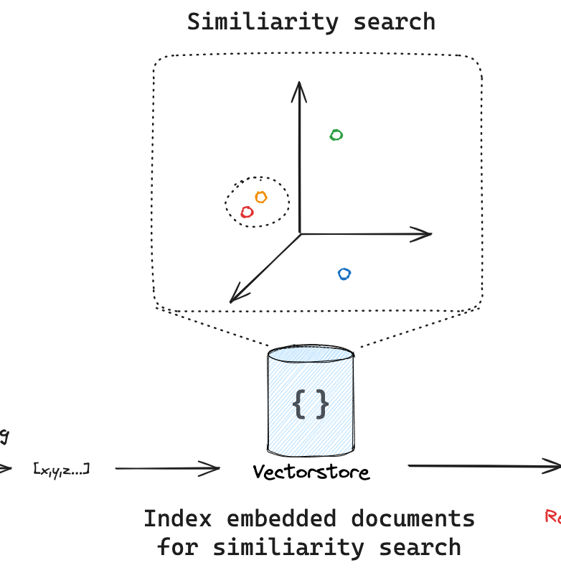
Vector stores have revolutionized the way we build similarity search applications, enabling efficient storage and retrieval of data based on high-dimensional embeddings. By understanding the inner workings of vector stores and the diverse options available, you can leverage this powerful technology to create innovative applications that deliver accurate and relevant results to your users, transforming the way they interact with information.

